Slide 1

CellForge: Agentic Design of Virtual Cell Models
Robert Xiangru Tang
Department of Computer Science, Yale University
Mon., Jan 26, 2025
xiangru.tang@yale.edu, Twitter/X: @XiangruTang
Notes:
Today I’ll talk about CellForge: Agentic Design of Virtual Cell Models.
In this talk, I’ll use virtual cell modeling as a concrete case study to show how multi-agent AI scientists can design novel architectures, validate them biologically, and even solve real clinical problems.

Slide 2
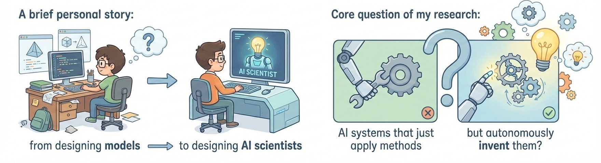
Why I care about AI Scientists
Core question of my research: Can we build AI systems that do not just apply methods, but autonomously invent them?
Notes:
Let me start with the core question that drives my research. Can we build AI systems that do not just apply methods — but autonomously invent them? Like many of us, I started by manually designing machine learning models: choosing architectures, tuning components, debugging pipelines. Over time, I realized that much of scientific progress is actually about method invention. Scientists don’t just run tools — they create new ones when existing approaches fail. So the long-term goal of my work is not to build better predictors, but to build AI scientists that can reason, design, and innovate.

Slide 3
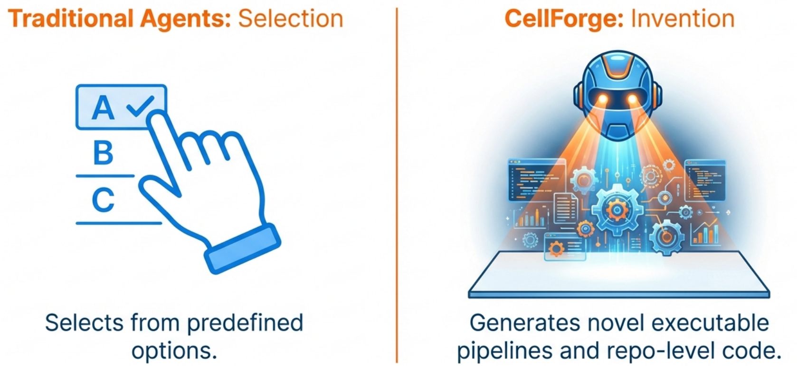
From Deciding to Building
Science also requires inventing new methods.
If agents can reason like scientists, can they also invent new scientific methods?
Notes:
Most current AI agents they do a lot question answering and reasoning tasks. But real science is a building process. CellForge represents this shift: from agents that select the right answer to agents that generate novel executable scientific methods.

Slide 4
CellForge – Agentic Design of Virtual Cell Models
Virtual cell modeling: Predicting cellular responses (e.g., gene expression changes) to genetic, chemical, and environmental perturbations.
Notes:
The scientific testbed we use is virtual cell modeling. The goal is to predict cellular responses to perturbations — such as gene knockouts, drug treatments, or environmental changes. Given pre-perturbation cellular states, the model must infer post-perturbation profiles.

Slide 5
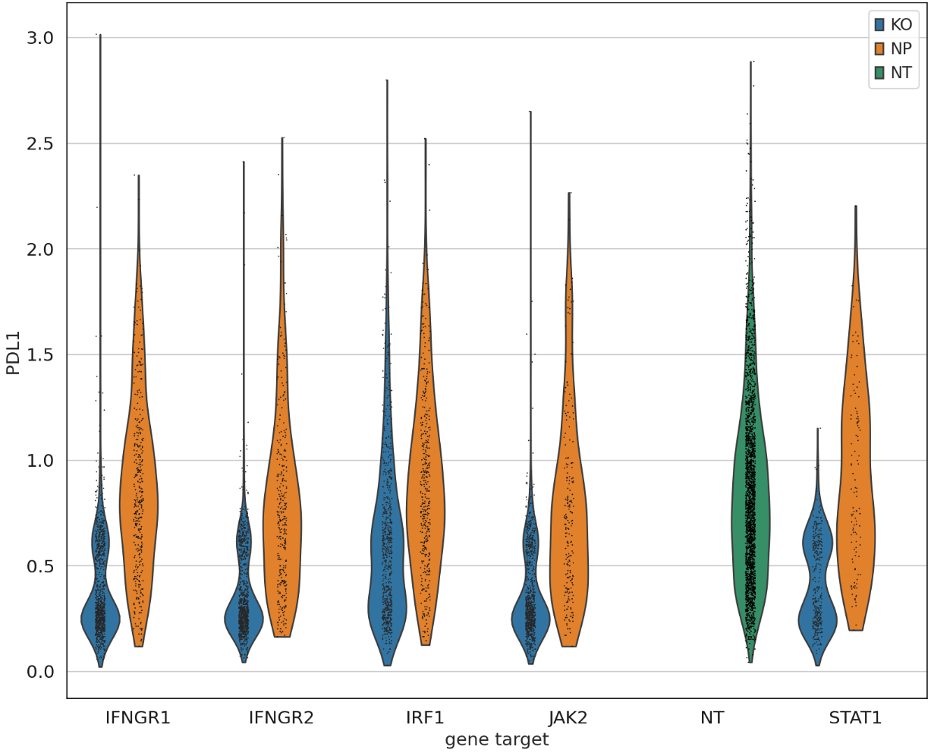


CellForge – Agentic Design of Virtual Cell Models
Why virtual cell modeling is fundamentally hard? Why Multi-Agent System?
● Extreme Dataset-Specific Inductive Bias
● Failure of Single LLM and AutoML in Architecture Invention
Launching workflow executor (this may take a while)...
Answer
Chemical Perturbation Gene Expression Prediction: Complete Analysis, Method, and Code Report
Executive Summary
I have developed a comprehensive machine learning framework for
predicting transcriptional responses to chemical perturbations in human cell lines. This framework is specifically designed for the sci-Plex methodology from Srivatsan et al. (Science 2020) [1] and addresses the critical challenge of predicting gene expression changes
following compound treatments across different cellular contexts.
Model Architecture
RandomForestRegressor(n_estimators=200, max_depth=20, min_samples_split=5, random_state=42, n_jobs=-1)
...
● Fragility of Human-Designed Pipelines
scRNA-seq
√
scATAC-seq
×
Scientific discovery requires more than tool calling
Notes:
There are some difficulties. First, extreme dataset-specific inductive bias. Each perturbation dataset has different biological mechanisms, different noise distributions, and different sparsity. Foundation models often fail to generalize across them. Second. Today, researchers manually inspect data, design architectures, run experiments, and iterate. Each new dataset often requires redesigning the entire modeling approach.

Slide 6
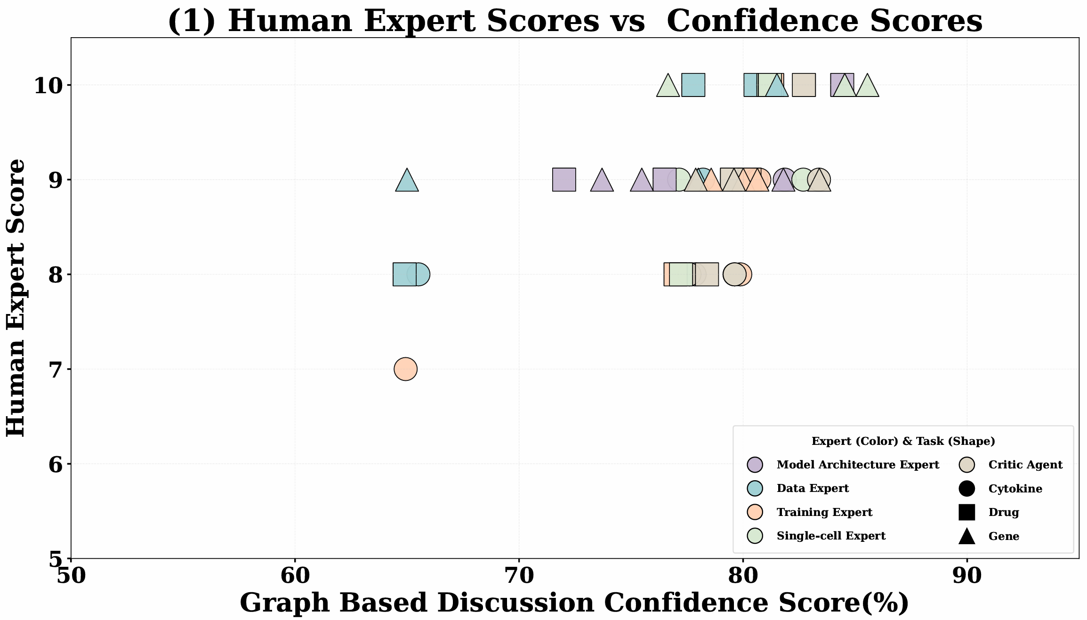
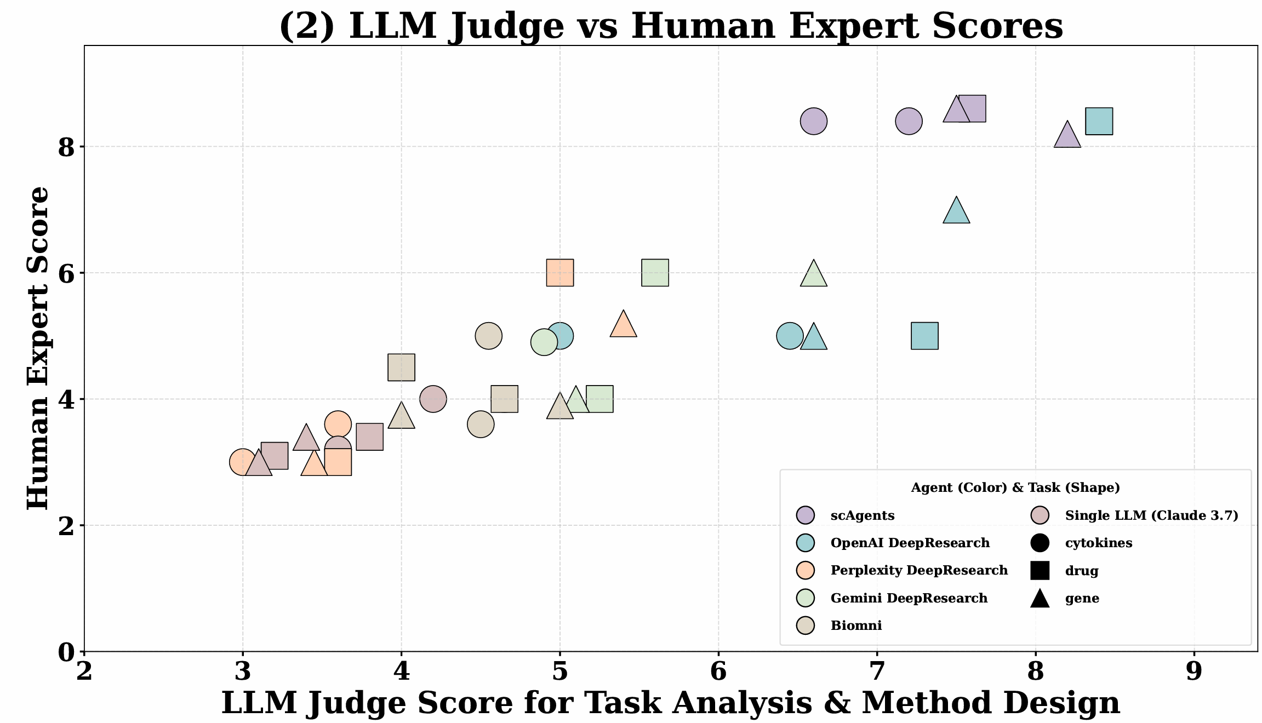
CellForge – Agentic Design of Virtual Cell Models
Why Multi-Agent System? Compare Cellforge with single LLM and other agentic systems
Notes:
To address these challenges, we designed CellForge as a multi-agent scientific reasoning system. We compared it against single LLMs and existing agentic systems. Across multiple perturbation tasks, CellForge consistently generates higher-quality research plans — in scientific validity, feasibility, and innovation. Importantly, both LLM judges and blinded human experts agree on these improvements.

Slide 7
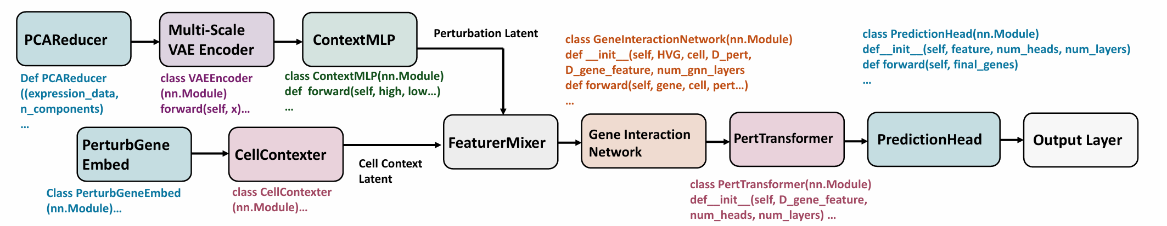
CellForge – Agentic Design of Virtual Cell Models
From models to methods: towards autonomous scientific discovery
Example of Models Designed by CellForge
Figure 1: An example diagram of the model framework designed by CELLFORGE on the scRNAseq gene knockout perturbation prediction task (Norman et al.).
CellForge is not intended to build a superior predictive model, but rather to realize an automated discovery paradigm capable of autonomously inventing scientific methods.
CellForge suggests a future where AI does not just apply methods, but invents them.
Notes:
These models emerge from reasoning over data characteristics and biological knowledge. Nothing here is predefined. They combine components like latent encoders, gene interaction networks, and perturbation-aware transformers in novel ways.

Slide 8
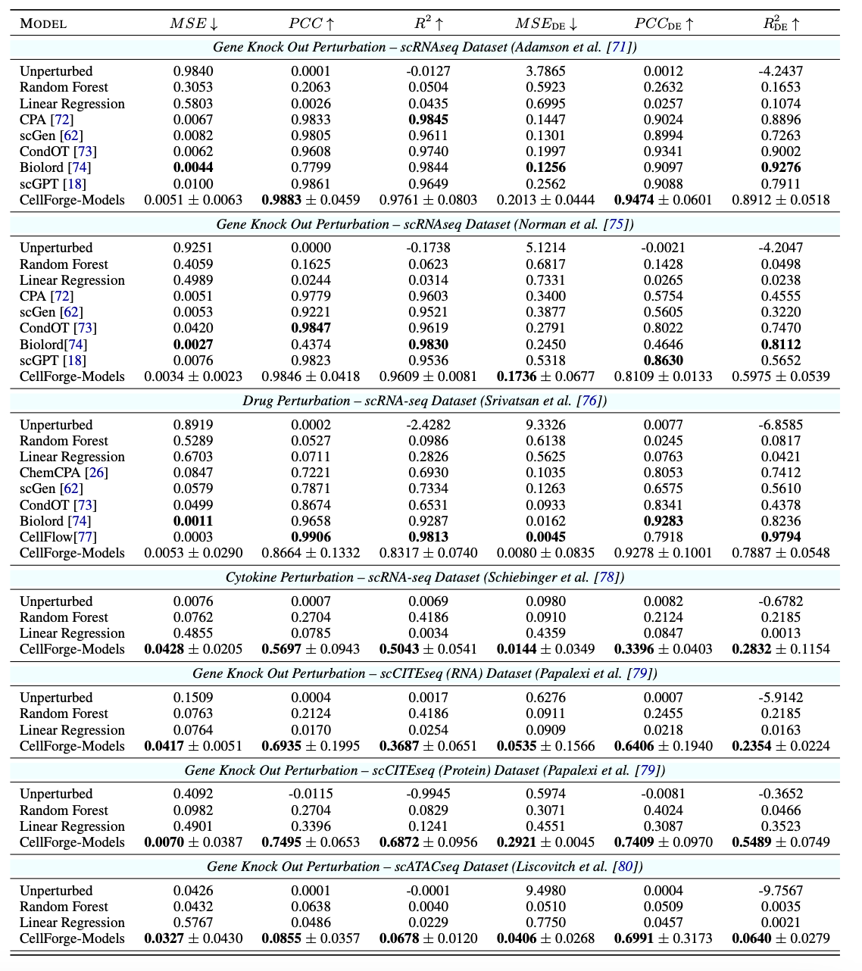
CellForge – Agentic Design of Virtual Cell Models
Results: Benchmarking CellForge Created Model for Perturbation Prediction Tasks
Commonly Used Modality
New Modality
Notes:
We first benchmarked on scRNA-seq gene knockout and drug perturbation tasks. Compared to strong baselines like scGPT and Geneformer, CellForge-designed models substantially reduce prediction error and improve variance explained. In many cases, they outperform hand-designed architectures. We then tested generalization to new modalities such as scATAC-seq and CITE-seq, where the same system adapts without manual re-engineering.

Slide 9
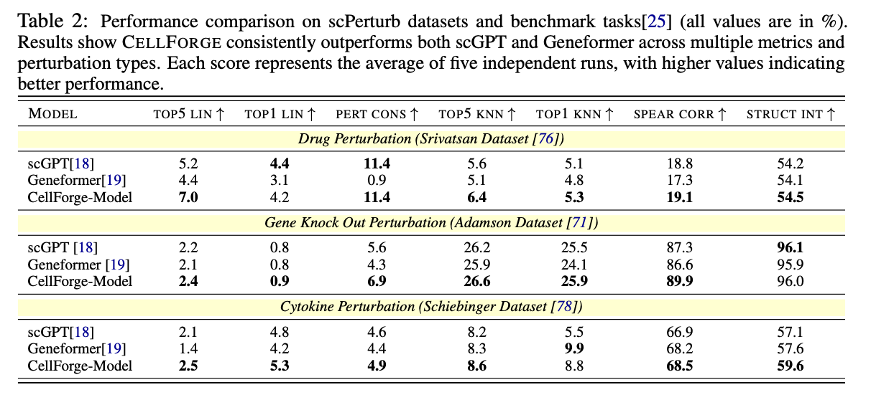
CellForge – Agentic Design of Virtual Cell Models
Results: Benchmarking Quality of Cell Representation of CellForge Created Models.
Notes:
Beyond prediction accuracy, we evaluated representation quality. CellForge embeddings consistently show better separability, perturbation consistency, and structural preservation than foundation models. This indicates the system is learning biologically meaningful latent spaces.

Slide 10
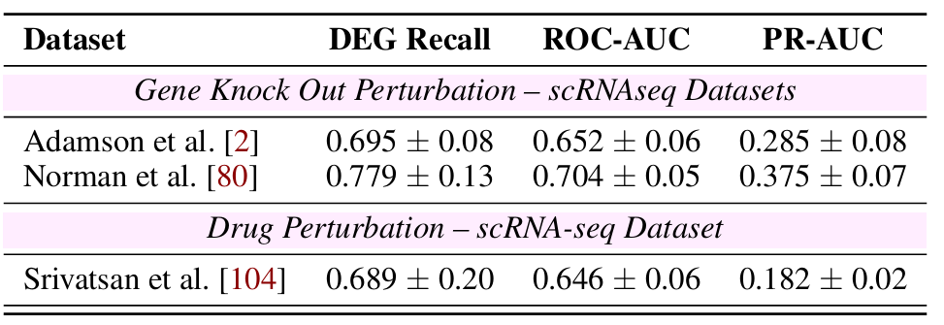
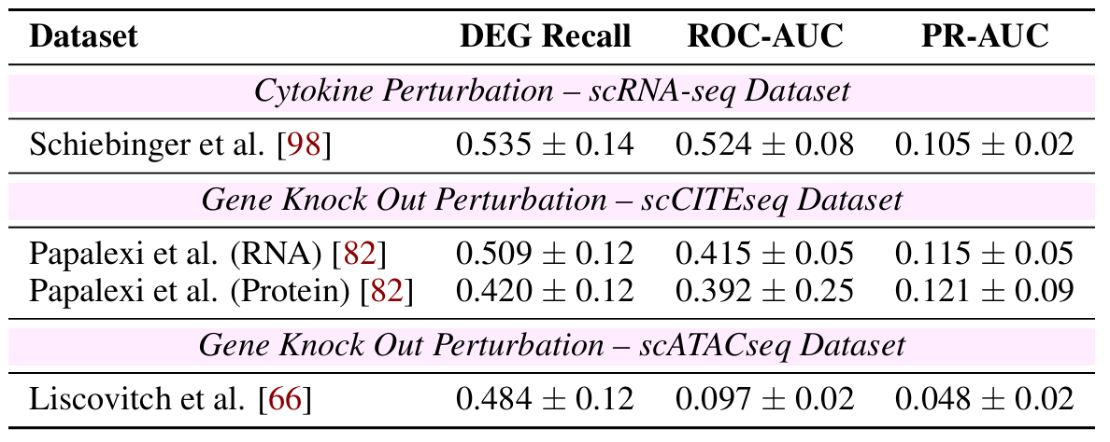
CellForge – Agentic Design of Virtual Cell Models
Biological Validation: DEG Recovery Performance
Commonly Used Modality
New Modality
Notes:
We then evaluated whether the model recovers the key features that actually respond to perturbations. Instead of overall error, this focuses on the strongest response signals — the dimensions that carry real causal effects. CellForge consistently captures most of these true response features. This indicates high sensitivity to meaningful biological changes rather than noise.

Slide 11
CellForge – Agentic Design of Virtual Cell Models
Biological Validation: KEGG Pathway Enrichment Analysis
Notes:
We also validated predictions at the pathway level using KEGG enrichment — a standard biological mechanism-level evaluation. Rather than individual genes, this tests whether predictions recover coherent functional processes. The results show strong alignment with known cellular mechanisms. So the models learn structured biology, not just correlations.

Slide 12
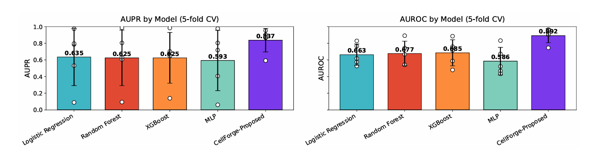
CellForge – Agentic Design of Virtual Cell Models
Application case (1): Predicting CAR-T Therapy Response for Refractory B Cell Lymphoma from Patient Single-Cell Profiles
Notes:
We applied CellForge to a real-world intervention outcome prediction task using high-dimensional single-cell data. The discovered architecture automatically learns to attend to the most informative subpopulations, rather than treating all instances equally. This demonstrates strong generalization beyond controlled benchmark settings.

Slide 13
CellForge – Agentic Design of Virtual Cell Models
Application case (2): Interpretable Cardiomyopathy Disease Subtype Prediction With Single-Nucleus Profile Of Patient Heart Cells
Notes:
We also evaluated CellForge on an interpretable multi-class prediction problem in complex biological data. The automatically designed model achieves near-perfect classification accuracy.

Slide 14
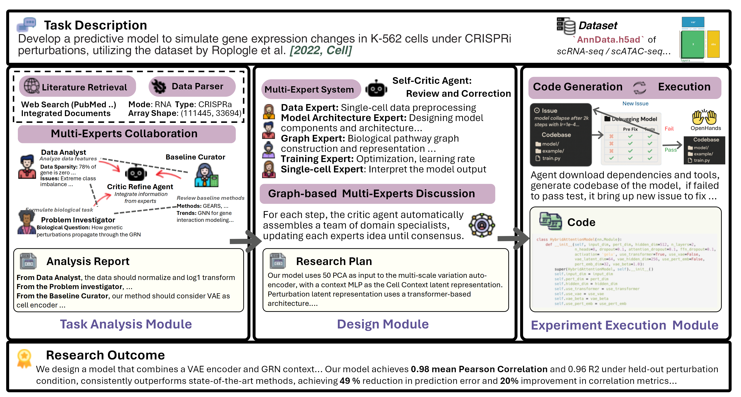
CellForge – Agentic Design of Virtual Cell Models
CellForge Multi-agent System Workflow:
Raw Data + Task → [Task Analysis] → [Design Module] → [Experiment Execution] → Working Model Code
Notes:
Let me briefly summarize how CellForge operates. Given raw multi-omics data and a natural language task description, the system outputs a fully implemented and optimized model. The pipeline consists of three stages: task understanding, collaborative method design, and automated experimentation.

Slide 15
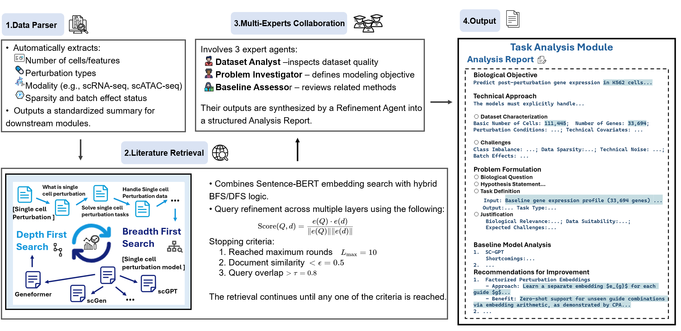
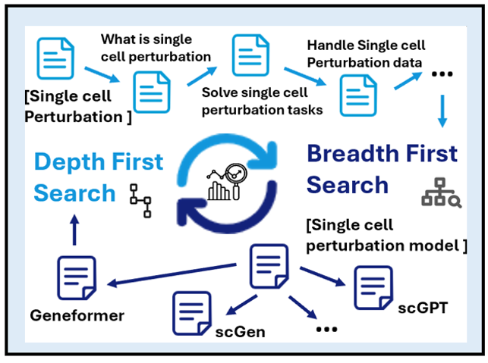
CellForge – Agentic Design of Virtual Cell Models
CellForge Task Analysis Module
Notes:
The task analysis module automatically characterizes datasets and retrieves relevant scientific knowledge. It diagnoses limitations of existing approaches and identifies key challenges before model design begins.

Slide 16
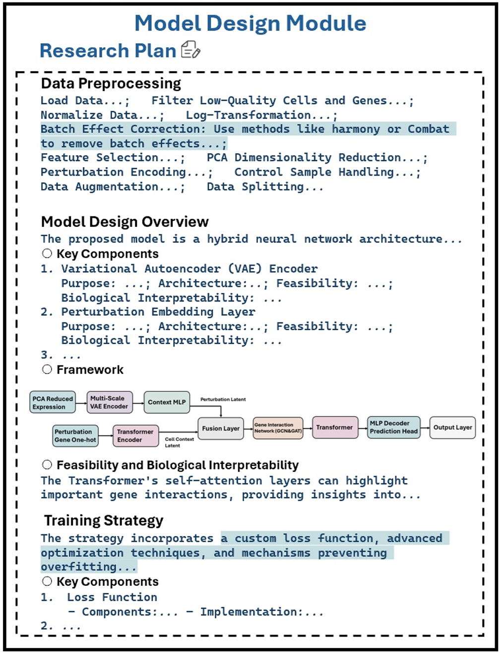
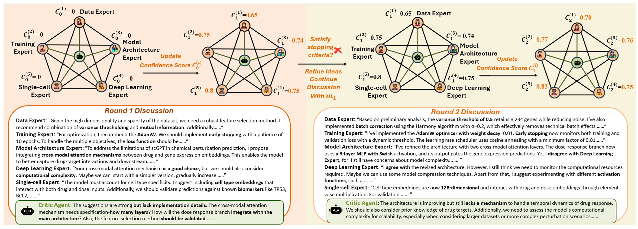
CellForge – Agentic Design of Virtual Cell Models
CellForge Design Module
How does it do that? Detailed workflow of updating: confidence score:
Agents iteratively converge when independent experts agree
Notes:
In the design module, specialized agents propose architectures and critique each other through structured discussion. Confidence scoring guides convergence until independent experts agree on a novel method. This replaces single-chain reasoning with collaborative scientific debate.

Slide 17
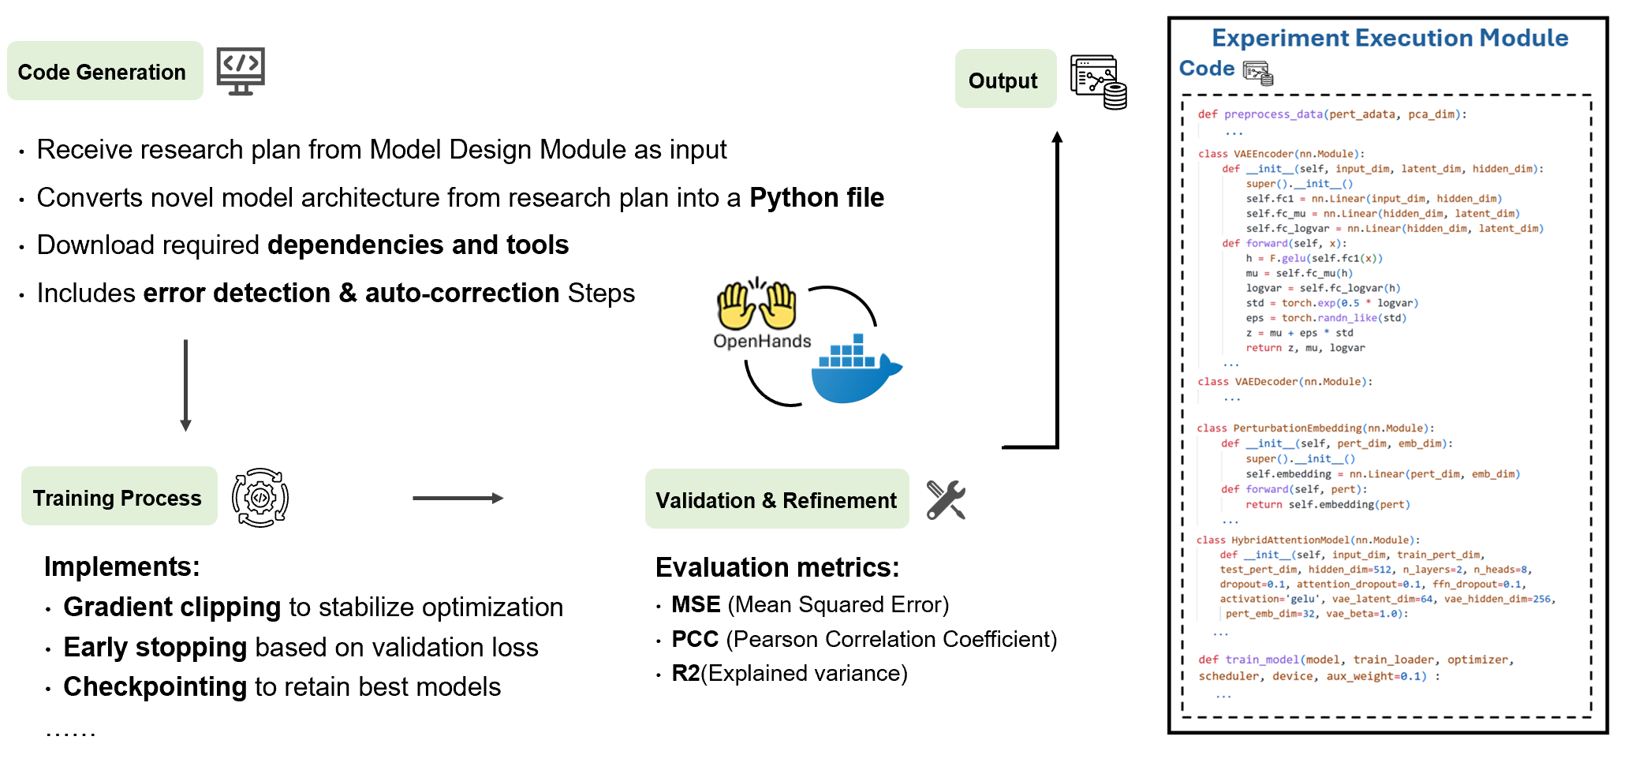
CellForge – Agentic Design of Virtual Cell Models
CellForge Experiment Execution Module
Notes:
The system then converts research plans into executable code. It runs training, validation, and iterative refinement automatically.

Slide 18
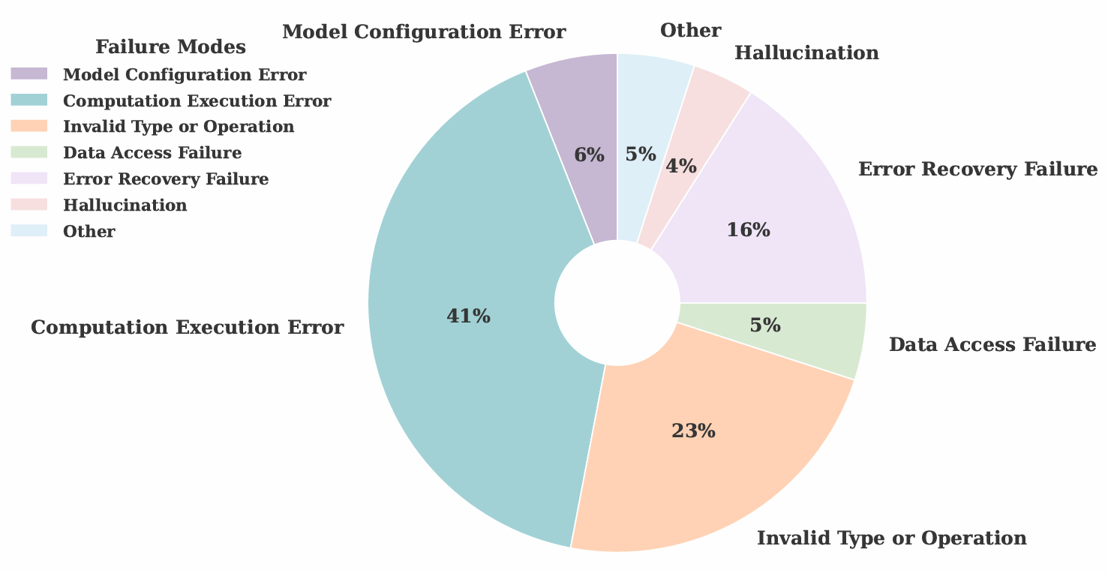
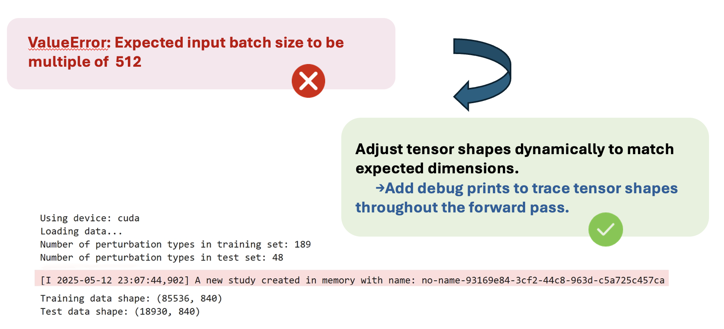
CellForge – Agentic Design of Virtual Cell Models
CellForge failure case analysis & automatic correction strategy example
Notes:
Common failure patterns such as invalid operations or shape mismatches are detected and repaired. This enables fully autonomous end-to-end discovery.

Slide 19




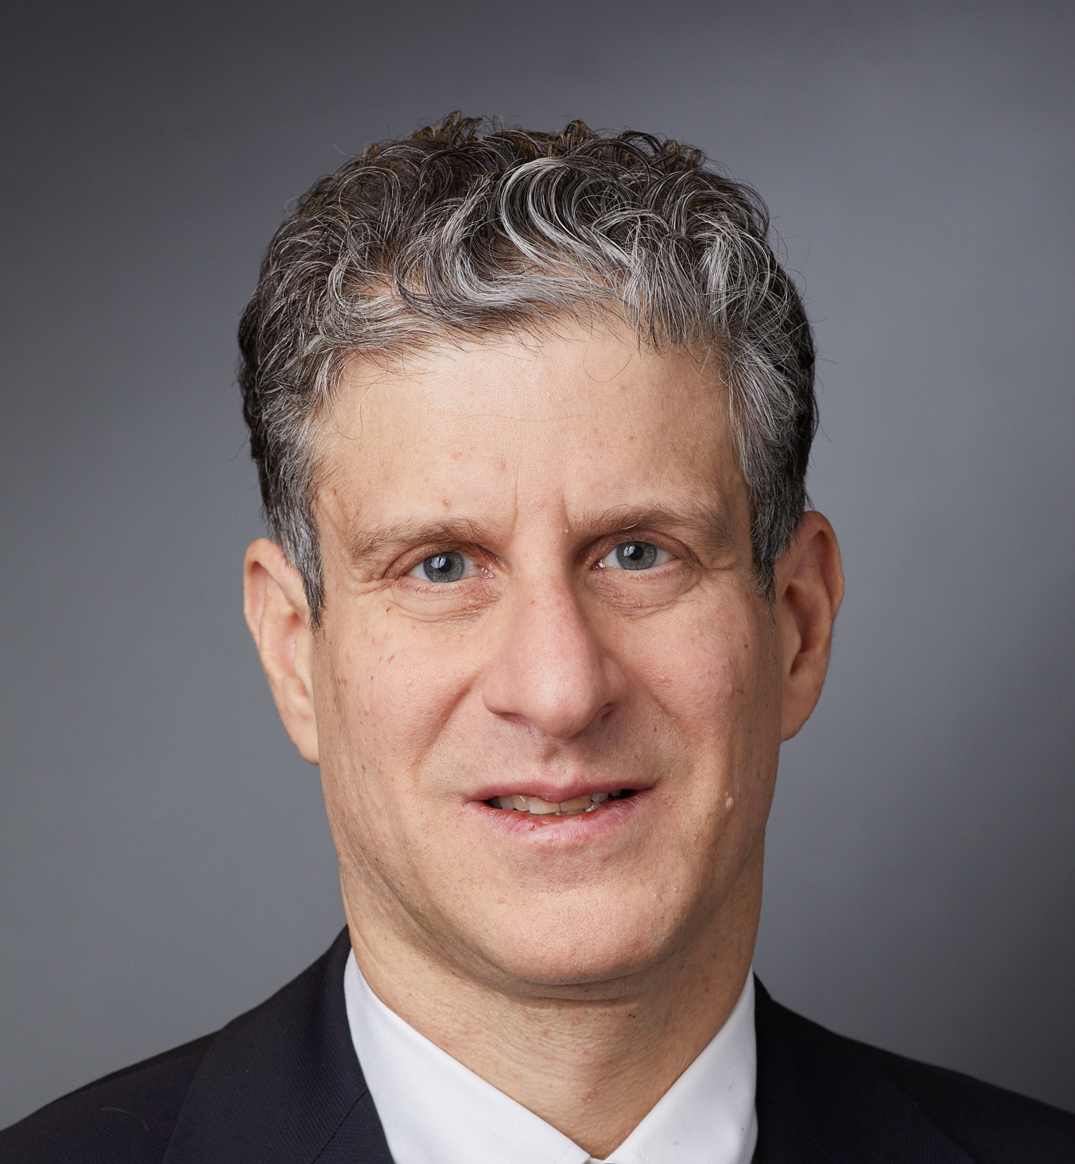



Thanks to my advisors and collaborators. It’s a team effort.
Some of my research supported by:
If you have questions:
xiangru.tang@yale.edu
@XiangruTang
@Gersteinlab
Notes:
And finally I would like to give a big shoutout to my collaborators, the Gerstein Lab, and my advisor for their support and contributions throughout the project. They helped make the work possible. For more details, visit our project website or check our paper here. Overall, CellForge demonstrates a new paradigm for scientific AI. Instead of applying fixed models, multi-agent systems can autonomously invent methods, validate them structurally, and generalize to real-world problems.

